Slide 1
How Microsoft is Democratizing AI

Slide 2

>whoami
Cloud Solution Architect @ Microsoft.
Big Data, Advanced Analytics, Artificial Intelligence.
http://www.johndehavilland.com
@johndehavilland
Disclaimer: The opinions and comments made throughout this presentation are my own and not those of my employer.

Slide 3
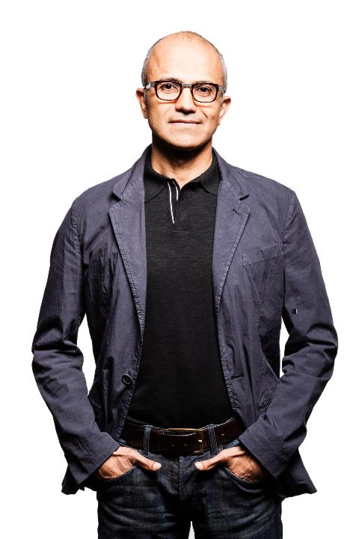
“OUR GOAL IS TO DEMOCRATISE A.I.
TO EMPOWER EVERY PERSON
AND EVERY ORGANISATION
TO ACHIEVE MORE”
Satya Nadella
Notes:
Despite the rapid growth in information, there's still one thing that remains constant:
Time - we are still constrained by our human capacity to absorb it.
So, how can we use all we have in terms of computational power to make better sense of the world in the time we have?
That's the essence of what AI is,“
That is why our goal is to democratize AI - to help people achieve more
“Technology is reshaping society as we know it.”
Key points to land
Technology is reshaping society
Timeless values must endure
It’s about augmenting, not replacing, the human experience

Slide 4
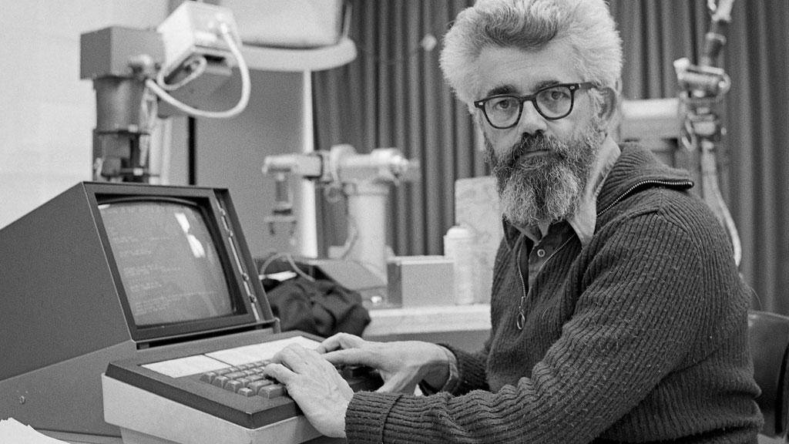
“The science and engineering of making intelligent machines” – John McCarthy
Notes:
What is AI.
It was in the mid-1950s that McCarthy coined the term “Artificial Intelligence” which he would define as “the science and engineering of making intelligent machines”.
McCarthy also created LISP
In 1960, when he opined that “computation may someday be organized as a public utility” the underlying concept of cloud computing was stated.

Slide 5

Why now?
Sphinx voice recognition
1992
Powerful algorithms
Grant calculator
1877
Shakey reasoning robot
1969
Compute power
VaMP self-driving car
1994
Big Data
AT&T Voder
1939
GUI
1981
Mechanical
Electronics
Computers
Cloud + AI
Notes:
AI is not new. We’ve been in a journey for decades to augment human capabilities in one of those three areas.
Think about the first calculators, which could do better than humans even with mechanical options like the Grant calculator in 1877.
Electronics then opened a new frontier for AI. Natural experiences like Voder, a machine able to mimic human voice. Or first attempts on reasoning machines.
Then computers, bringing graphical user interfaces, voice recognition or self driving cars as early as 1994.
Then why are we talking about AI now? The progress all these decades has been linear, with even some setbacks. However, three things are dramatically changing the speed of innovation:
Advances in AI algorithms, in particular deep learning with neural networks.
Huge compute power available in the cloud.
Big data, able to train these algorithms with huge sets of data.

Slide 6
Microsoft & Machine Learning Answering questions with experience
1991
1997
2008
2009
2010
2014
2015
Microsoft Research formed
Hotmail launches
Which email is junk?
Bing maps launches
What’s the best way home?
Bing search launches
Which searches are most relevant?
Kinect launches
What does that motion “mean”?
Skype Translator launches
What is that person saying?
Azure Machine Learning GA
What will happen next?
Machine learning is pervasive throughout Microsoft products.
Notes:
Microsoft has been working on machine learning for over two decades. We formed Microsoft research back in 1991 to tackle the tough problems internally that we’re enabling you to tackle yourselves today.
When we think of learning from experience – past data + human input – a great example is Hotmail. Back in 1997, external email was a relatively new concept. There wasn’t a lot to go on in terms of what email the customer wants and what they do not. With the rise of email, also came spam – and lots of it. Some of those issues were easy – like Nigerian princes we learned pretty quickly don’t give away their fortunes to strangers. But what about “free offer” – maybe that free offer is something the customer always wanted. Maybe it’s something they’d never want. But that’s where the “human input” part comes in as data is being collected – that takes the form of the actual user of the email service saying “yes, this is junk” or “no, I want this” and then the data scientist learning in aggregate and making tweaks to the underlying model in response.
And we kept going with that learning – relying on past data and human input to solve problems like the best way home, which search results are most meaningful to the user and one of the toughest ones to tackle with Kinect. Kinect’s past data was all in the lab – we didn’t have a product in market that captured user input and translated that to active game play so we had to make up the variables. But that only takes us so far. The researchers told me that one thing they didn’t consider was people answering the phone while playing. This happens a lot – and Kinect at first was translating this as a wild motion in the game play – essentially crashing people’s cars or any number of unintended consequences. That was the human input we rely on, which allowed us to learn quickly and adjust the underlying model to ensure that answering the phone would not be considered part of the game moving forward.
Skype translator is another huge machine learning problem to solve if you think of all the ways a person who is speaking English can pronounce the same word – tom-A-to or tom-AH-to – that’s the same word in French so Skype has to adjust quickly to ensure all the millions of variables are considered.
But what about using all this learning to predict what’s next? Many of the same algorithms running behind the scenes of our products in market today are available within Azure ML, allowing you to take your own past data and learn from it what will happen in the future for your business.

Slide 7
Microsoft Research

Slide 8
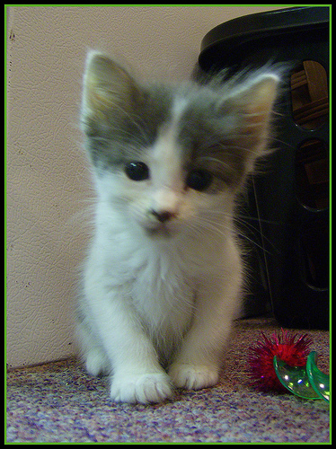
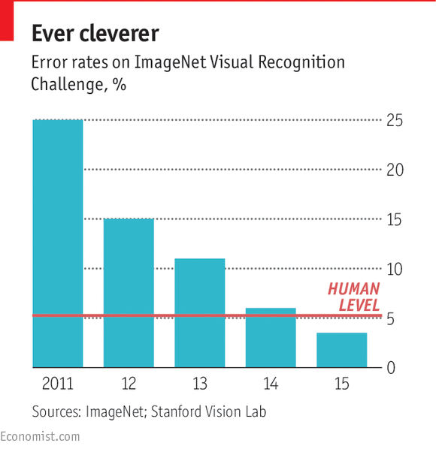
Loud and clear
Breakthroughs in vision
Speech-recognition word-error rate, selected benchmarks, %
Cat
152 layers
Switchboard
Switchboard cellular
RESNET
Meeting speech
Broadcast speech
IBM, Switchboard
5.8%
Microsoft, Switchboard
1993 | 1996 | 1998 | 2000 | 2002 | 2004 | 2006 | 2008 | 2010 | 2012 | 2014 | 2016
Sources: Microsoft: research papers
Notes:
ImageNet dataset
Deep Residual Networks
(ResNet) takes CNN a step further with “small” but “important” changes in the architecture. If we would like to itemize the advantages of the ResNet
Resdiual network approach allowed to build a really deep NN reducing the problem that arises vanishing gradient. Similar in a way to LSTM

Slide 9

Loud and clear
Speech-recognition word-error rate, selected benchmarks, %
Breakthroughs in speech
Switchboard
5.9% human error rate
Switchboard cellular
Meeting speech
Broadcast speech
Switchboard
IBM, Switchboard
5.1%
Microsoft, Switchboard
1993 | 1996 | 1998 | 2000 | 2002 | 2004 | 2006 | 2008 | 2010 | 2012 | 2014 | 2016 | 2017
Sources: Microsoft: research papers
Notes:
Switchboard is a corpus of recorded telephone conversations that the speech research community has used for more than 20 years to benchmark speech recognition systems. The task involves transcribing conversations between strangers discussing topics such as sports and politics.
We reduced our error rate by about 12 percent compared to last year’s accuracy level, using a series of improvements to our neural net-based acoustic and language models. We introduced an additional CNN-BLSTM (convolutional neural network combined with bidirectional long-short-term memory) model for improved acoustic modeling. Additionally, our approach to combine predictions from multiple acoustic models now does so at both the frame/senone and word levels.
Moreover, we strengthened the recognizer’s language model by using the entire history of a dialog session to predict what is likely to come next, effectively allowing the model to adapt to the topic and local context of a conversation.
Our team also has benefited greatly from using the most scalable deep learning software available, Microsoft Cognitive Toolkit 2.1 (CNTK), for exploring model architectures and optimizing the hyper-parameters of our models. Additionally, Microsoft’s investment in cloud compute infrastructure, specifically Azure GPUs, helped to improve the effectiveness and speed by which we could train our models and test new ideas.
Reaching human parity with an accuracy on par with humans has been a research goal for the last 25 years. Microsoft’s willingness to invest in long-term research is now paying dividends for our customers in products and services such as Cortana, Presentation Translator, and Microsoft Cognitive Services. It’s deeply gratifying to our research teams to see our work used by millions of people each day.

Slide 10
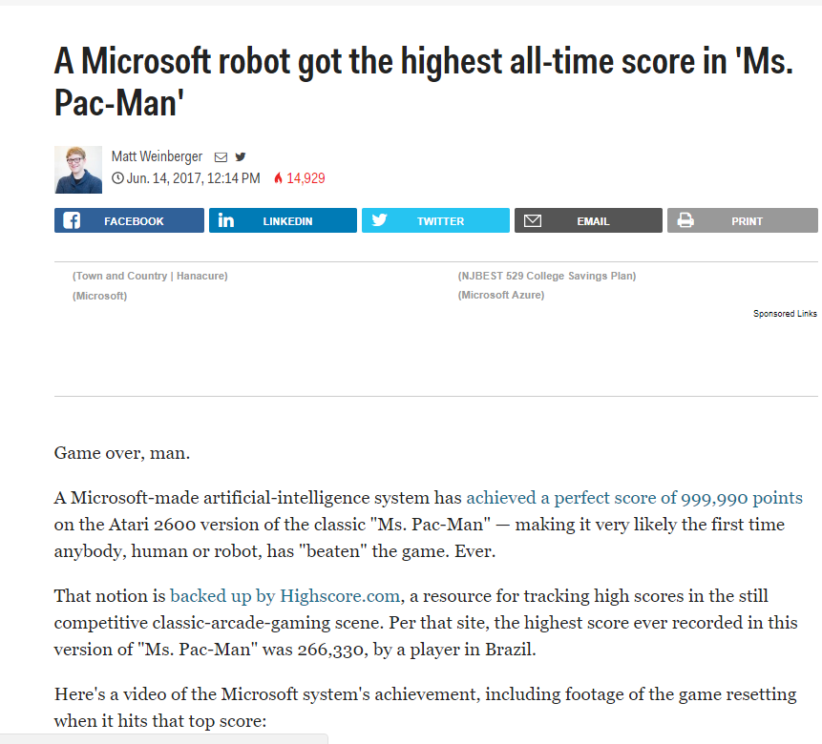
Notes:
https://blogs.microsoft.com/ai/divide-conquer-microsoft-researchers-used-ai-master-ms-pac-man/
The team from Maluuba, a Canadian deep learning startup acquired by Microsoft earlier this year, used a branch of AI called reinforcement learning to play the Atari 2600 version of Ms. Pac-Man perfectly. Using that method, the team achieved the maximum score possible of 999,990.
To get the high score, the team divided the large problem of mastering Ms. Pac-Man into small pieces, which they then distributed among AI agents.
The method, which the Maluuba team calls Hybrid Reward Architecture, used more than 150 agents, each of which worked in parallel with the other agents to master Ms. Pac-Man. For example, some agents got rewarded for successfully finding one specific pellet, while others were tasked with staying out of the way of ghosts.
Then, the researchers created a top agent – sort of like a senior manager at a company – who took suggestions from all the agents and used them to decide where to move Ms. Pac-Man.
Harm Van SeijenThe top agent took into account how many agents advocated for going in a certain direction, but it also looked at the intensity with which they wanted to make that move. For example, if 100 agents wanted to go right because that was the best path to their pellet, but three wanted to go left because there was a deadly ghost to the right, it would give more weight to the ones who had noticed the ghost and go left.
“A lot of companies working on AI use games to build intelligent algorithms because there’s a lot of human-like intelligence capabilities that you need to beat the games,” Mehrotra said.

Slide 11
Tesla later approached Morgan to ask for more funds to build a more powerful transmitter. When asked where all the money had gone, Tesla responded by saying that he was affected by the Panic of 1901, which he (Morgan) had caused. Morgan was shocked by the reminder of his part in the stock market crash and by Tesla’s breach of contract by asking for more funds.

Slide 12
Tesla later approached Morgan to ask for more funds to build a more powerful transmitter. When asked where all the money had gone, Tesla responded by saying that he was affected by the Panic of 1901, which he (Morgan) had caused. Morgan was shocked by the reminder of his part in the stock market crash and by Tesla’s breach of contract by asking for more funds.
On what did Tesla blame for the loss of the initial money?

Slide 13
Tesla later approached Morgan to ask for more funds to build a more powerful transmitter. When asked where all the money had gone, Tesla responded by saying that he was affected by the Panic of 1901, which he (Morgan) had caused. Morgan was shocked by the reminder of his part in the stock market crash and by Tesla’s breach of contract by asking for more funds.
On what did Tesla blame for the loss of the initial money?

Slide 14
R-NET (MSRA) is the first to surpass human EM (Exact Match) on the SQuAD Machine Reading Comprehension Challenge
Human EM Performance: 82.304
Surpass Human EM [2018.1.3]
Best System EM Scores on the SQuAD Machine Reading Comprehension Dataset since Dec. 2016
Notes:
Microsoft creates AI that can read a document and answer questions about it as well as a person
eached the human parity milestone using the Stanford Question Answering Dataset, known among researchers as SQuAD. It’s a machine reading comprehension dataset that is made up of questions about a set of Wikipedia articles.
With machine reading comprehension, researchers say computers also would be able to quickly parse through information found in books and documents and provide people with the information they need most in an easily understandable way.
For example, Microsoft is working on ways that a computer can answer not just an original question but also a follow-up. For example, let’s say you asked a system, “What year was the prime minister of Germany born?” You might want it to also understand you were still talking about the same thing when you asked the follow-up question, “What city was she born in?”
special kind of RNN is the Bi-directional RNN (BiRNN). While standard RNNs remember the historical context by ‘remembering’ past data, BiRNNs also traverse in the reverse direction, to understand context from the future:

Slide 15
Customer Stories

Slide 16

Paving the way for a new form of customer interaction with AI
Notes:
https://customers.microsoft.com/en-us/story/ups
intelligent applications that deliver relevant, seamless experiences to its customers on virtually any device
AI project. It complements UPS Mobile, particularly the app’s My Choice functionality, which customers use to customize the delivery process for their packages and to see when they’ll arrive. Kumar Athreya, Senior Applications Development Manager of Shipping Systems at UPS, says, “We first learned about the Bot Framework when Microsoft unveiled the technology at its 2016 Build conference. Using a bot to engage with customers was a fascinating idea, and we wanted to be early adopters.”
The engineers’ vision was to create a bot—or a robotic service representative—that customers could engage using text or voice commands via social media channels, mobile devices, and emerging virtual assistants, like Amazon’s Alexa. They also envisioned integrating the bot with My Choice to give customers another avenue for accessing their customized service settings.
“Within five weeks, we had developed a chatbot prototype with the Microsoft Bot Framework,”

Slide 17

We are using Azure Machine Learning to surface more content for readers who are interested in learning more about a story. And we are earning business value from videos that would otherwise go unwatched. -- Isaac Showman, Managing Director
Notes:
https://customers.microsoft.com/en-us/story/reuters-media-azuremachinelearning
enhance its news readers’ experience and generate more value from its visual assets, it used Microsoft Azure Machine Learning to build a video recommendation engine that matches news articles to related videos on the Reuters.com website
Azure ML to build recommendation algorithm.
Articles and descriptions stored in azure sql db.
Pyhton to do topic and entity extraction, location
AML to do article pairing with videos – 0 (no match) 1(good match) 2 (exact match)
Top matched video is paired with the arcticle
Updated every 15 mins to process new articles and videos
Seen increase in vidieo consumption by consumers on their site

Slide 18
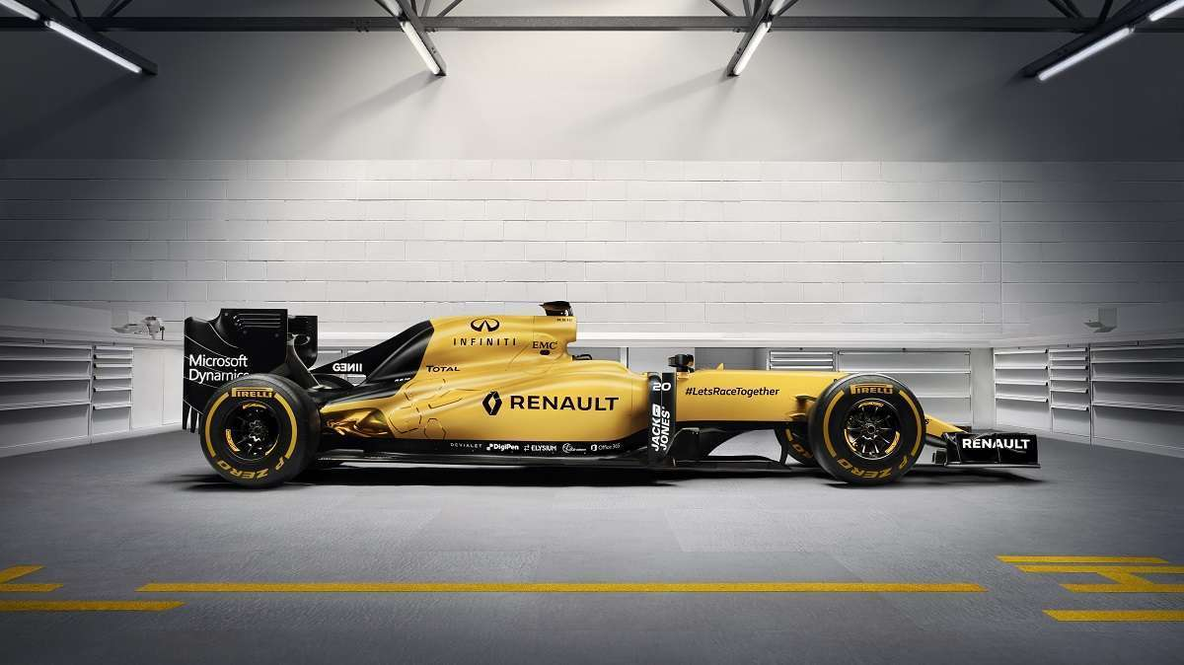
Renault Sport F1 Team
Notes:
In addition to Dynamics 365 for Operations and Power BI, Renault Sport Formula One Team is also taking advantage of Microsoft Azure Machine Learning, which the team is using to track all kinds of data, including the ambient temperature, track temperature, and information about the car’s tires. Once Renault Sport Formula One Team has all this data, it can integrate it into a simulator that can model how the car will perform in different situations.
Using Azure Machine Learning in the driver-in-the-loop simulator, the team can model tire temperature variations that are consistent with track conditions and the way the driver is driving, thus achieving a more realistic feel. As a result, team members can automate predictions—based on historical data and current conditions—of how Renault Sport Formula One cars will perform in future races.
Impact
Automated predictions on car performance
Real time simulations and collaboration to increase agility
Increased ability to quickly update under changing environments

Slide 19
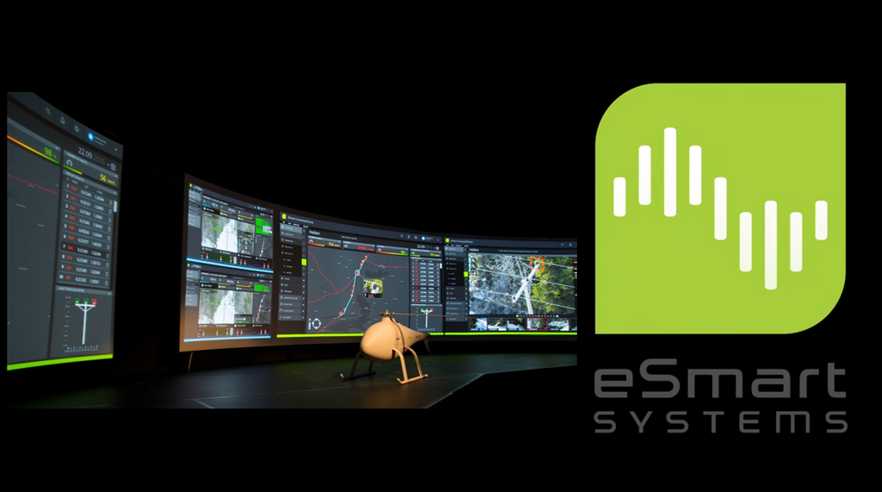

Slide 20
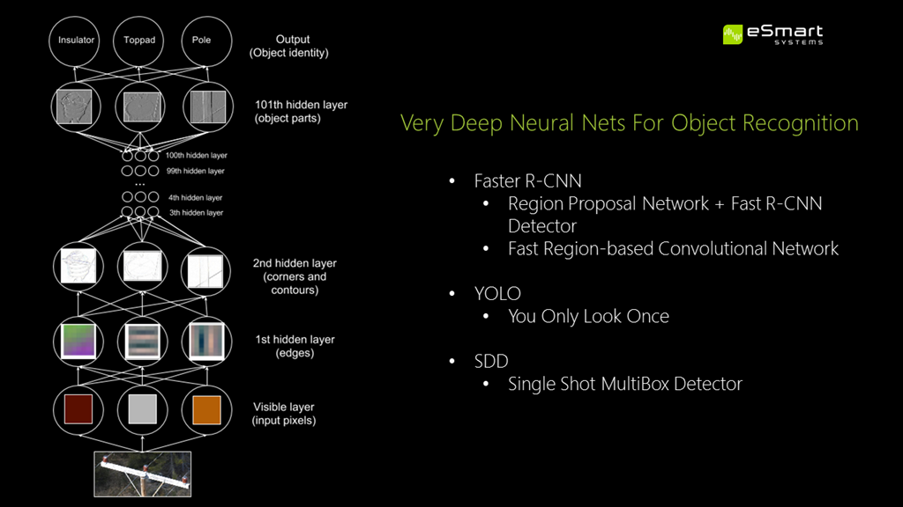

Slide 21
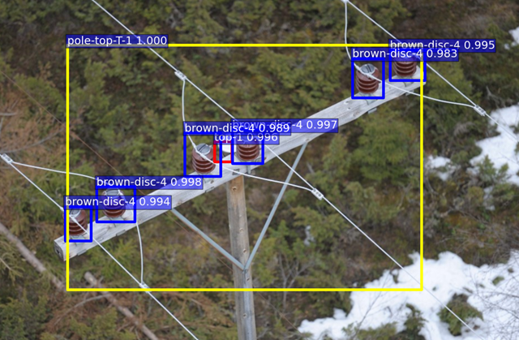
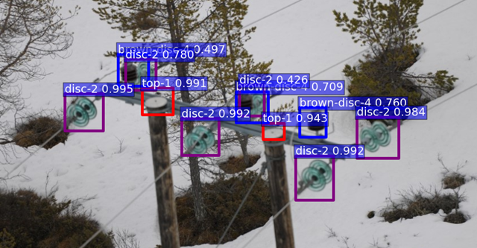

Slide 22
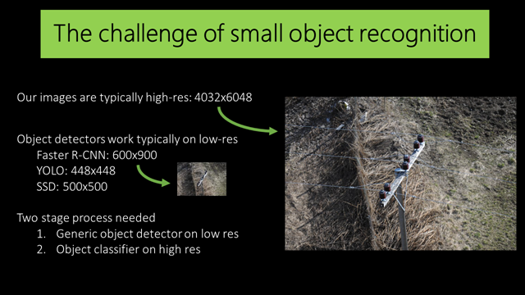

Slide 23
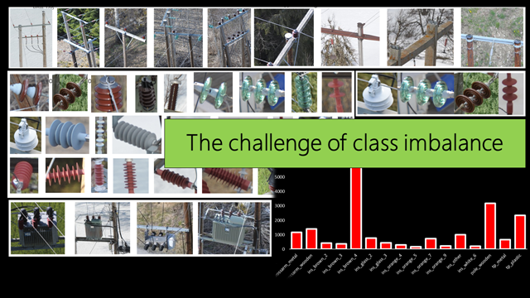

Slide 24
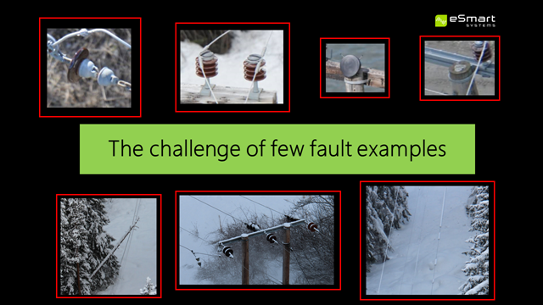

Slide 25
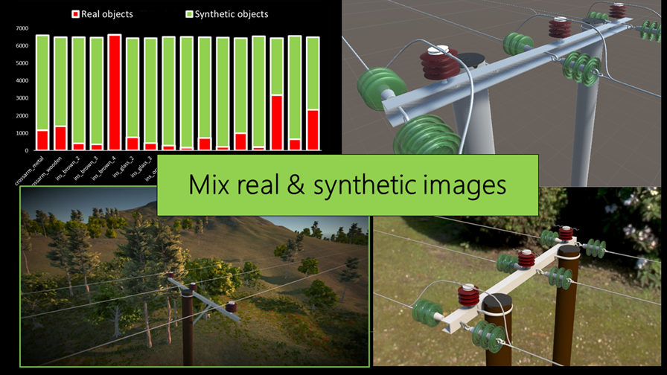

Slide 26

There’s no lack of data in our market today. Our goal is not data for the sake of data, but to embrace the cloud and analytical technologies to deliver more expert insights to the right stakeholders at the right time.
Nick Farrant, Senior Vice President
Notes:
https://customers.microsoft.com/en-us/story/rollsroycestory
Fuel generally accounts for a whopping 40 percent of airlines’ operating expenses
A clean engine burns less fuel, but washing engines is time consuming and expensive. Determining when the optimum time is for each of the engines in a fleet to get washed requires the analysis of a lot of data.
perform data modeling at scale to accurately detect operational anomalies and help customers plan relevant actions.

Slide 27

Azure Machine Learning significantly improved our hedging forecasts, saving real dollars during a period of volatile currency markets.
Brett Iversen, Senior Finance Director
Notes:
Revenue forecasting for critical-business decisions such as resource allocation, performance management, and inventory optimization
Impact
Accurate and automated forecast predictions on demand
Enhance business leaders’ expertise with data-driven, baseline forecasts
Today’s finance organizations face significant challenges in their forecasting processes with the exponential growth in the volume and availability of relevant data. Most organizations currently manage forecasts in spreadsheets or other products that use basic statistical analysis, and the workflow relies heavily on human judgement, email collaboration, and manual consolidation of data sets. In addition, forecasts can be biased, time consuming to create, and difficult to reproduce and integrate with new data streams.
The new analytics platform is based on components of Cortana Intelligence Suite, including Azure Machine Learning.
Azure Machine Learning generates forecasts, and Azure Data Factory stores the results in Azure SQL Database.

Slide 28

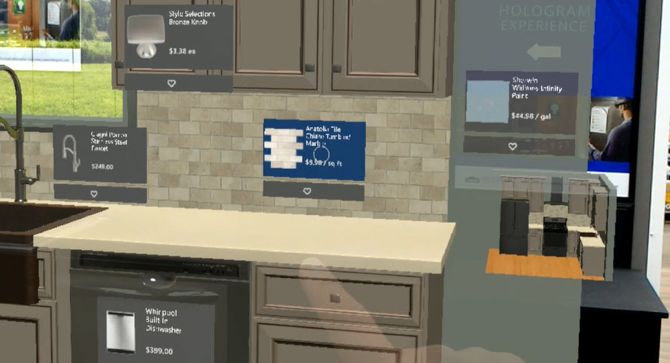
We’re not a tech company at heart, we’re a home improvement company. But what my team does is develop narrative-driven innovation, turning people and tech trends into a story. And then we turn those short stories into reality. We see technology and how it changes the way people act and interact.
Kyle Nel, executive director of Lowe’s Innovation Labs.
Notes:
Customer need
Provide an innovative, immersive customer design experience
Impact
Augmented consumer experience with HoloLens and AI
Quickly show and refresh design options

Slide 29
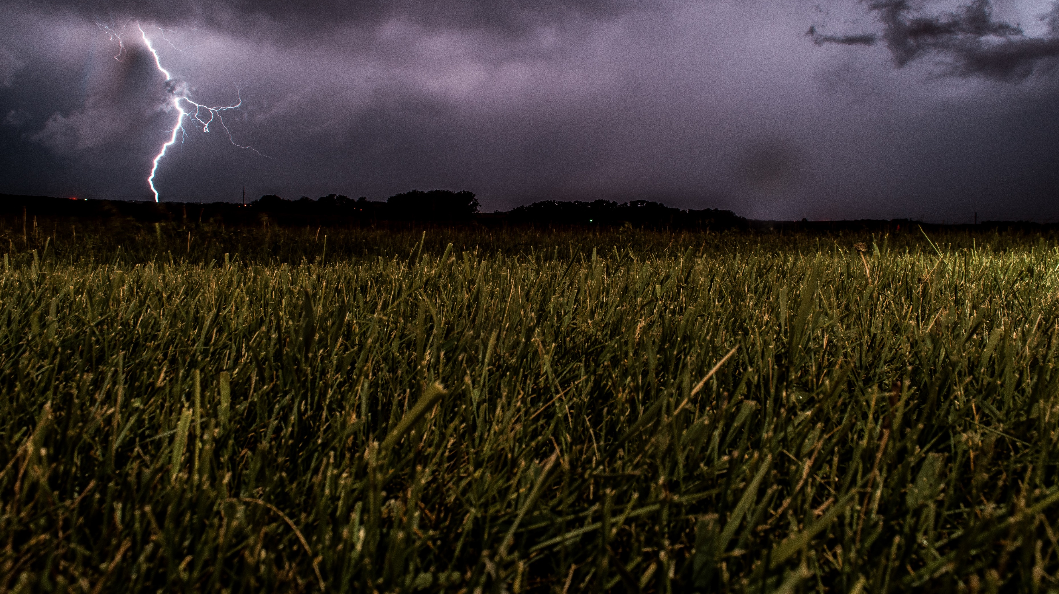

Weathering the storm: Big data and cloud technologies safeguard lives and businesses worldwide.
Notes:
Ultimately, making better business decisions means creating solutions that save lives and businesses. For example, on May 26, 2016, an AccuWeather enterprise solution warned Union Pacific Railroad that a tornado was going to cross a track in Kansas in about half an hour. The railroad stopped eight trains that were scheduled on that route, saving lives and millions of dollars. AccuWeather was also the first to predict the historic January 2016 blizzard that slammed the Eastern and Midwestern United States. With five days’ advance notice, big box retailer Lowe’s was able to get much-needed weather supplies to stores ahead of the storm.
And to improve supply-chain operations with predictive analytics, the company is using the Cortana Intelligence Suite to integrate sales data with weather information. In a recent project with Starbucks, AccuWeather helped the coffee giant solve seasonal problems like running out of ice and cups in hot weather. And in another example, AccuWeather helped a global candy manufacturer identify which products sold best, and if the sales spikes were weather-related.
While improving supply-chain operations might seem like an odd direction for a weather company, it’s not surprising when you consider that AccuWeather is all about using data to enhance lives. “Microsoft technologies enable us to innovate much quicker,” concludes Patti. “I think that the great story here is that there are so many integrated tools now that streamline workflow, consolidate data, and automate prediction so that we can stop worrying about infrastructure. We can just focus on our job, which is forecasting.”

Slide 30
Getting Started

Slide 31

Cognitive Services
Vision
Language
Speech
Search
Knowledge
Computer vision
Face
Emotion
Content Moderator
Video
Text analytics
Spell check
Web language model
Linguistic analysis
Translator
Speaker recognition
Speech
Web search
Image search
Video search
News search
Autosuggest
Academic knowledge
Entity linking service
Knowledge exploration
Recommendations
QnA maker
NEW Video Indexer
NEW Cognitive Services Labs
NEW
NEW
NEW
Custom
Custom
Custom
Custom
Custom
Vision Service
Language Understanding
Speech Service
Search
Decision Service
Notes:
[Optional slide for technical audiences]

Slide 32
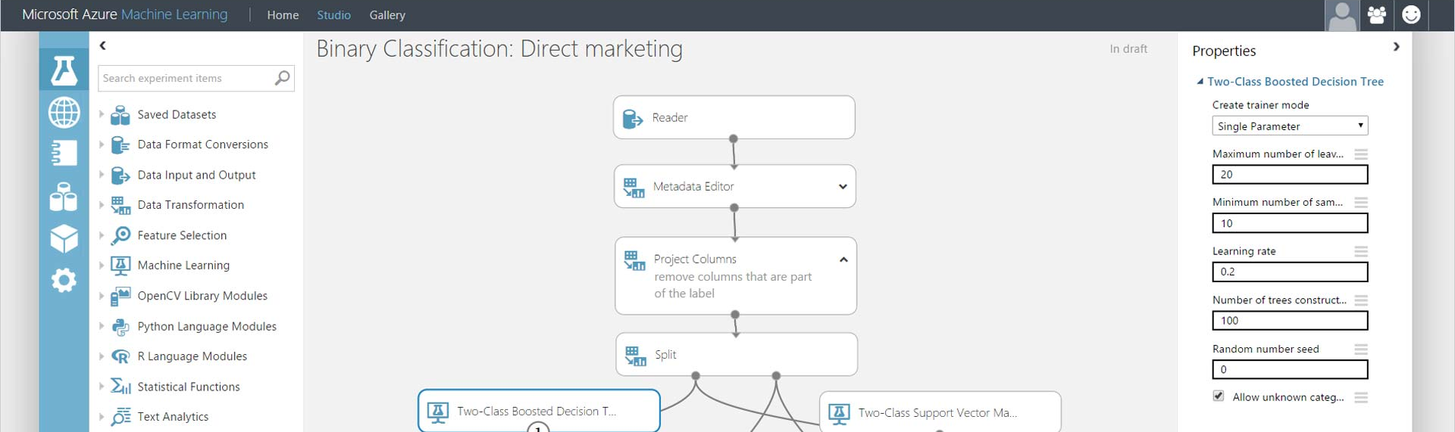
Azure Machine Learning
Integrated environment
Best-in-class algorithms
Deploy in minutes
Simple drag, drop, and connect interface for Data Science
Built-in collection of best-of- breed algorithms. R, CRAN packages, and Python
Train and operationalize models with a single click

Slide 33
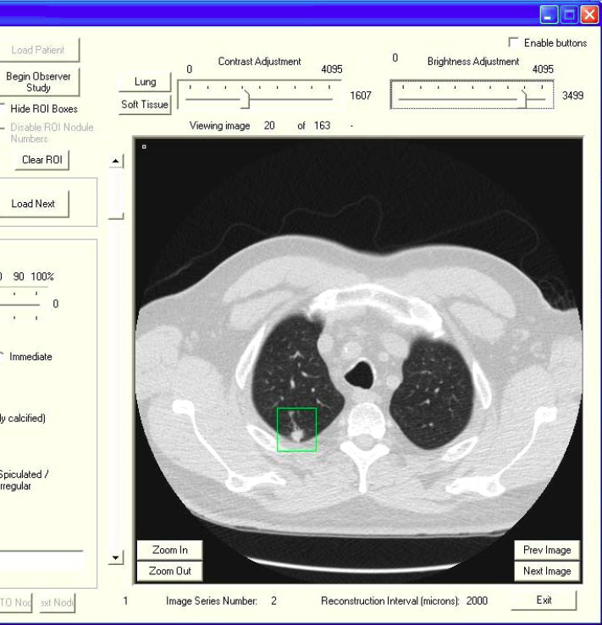
Deep Learning
Open environment
Cognitive Toolkit: performance, scale
Full support for TensorFlow, Caffee
Productive tools
Visual Studio
Jupyter Notebook
Azure AI infrastructure
The AI supercomputer: CPU, GPU, and (coming next) FPGA
Managed service with Batch AI Training

Slide 34
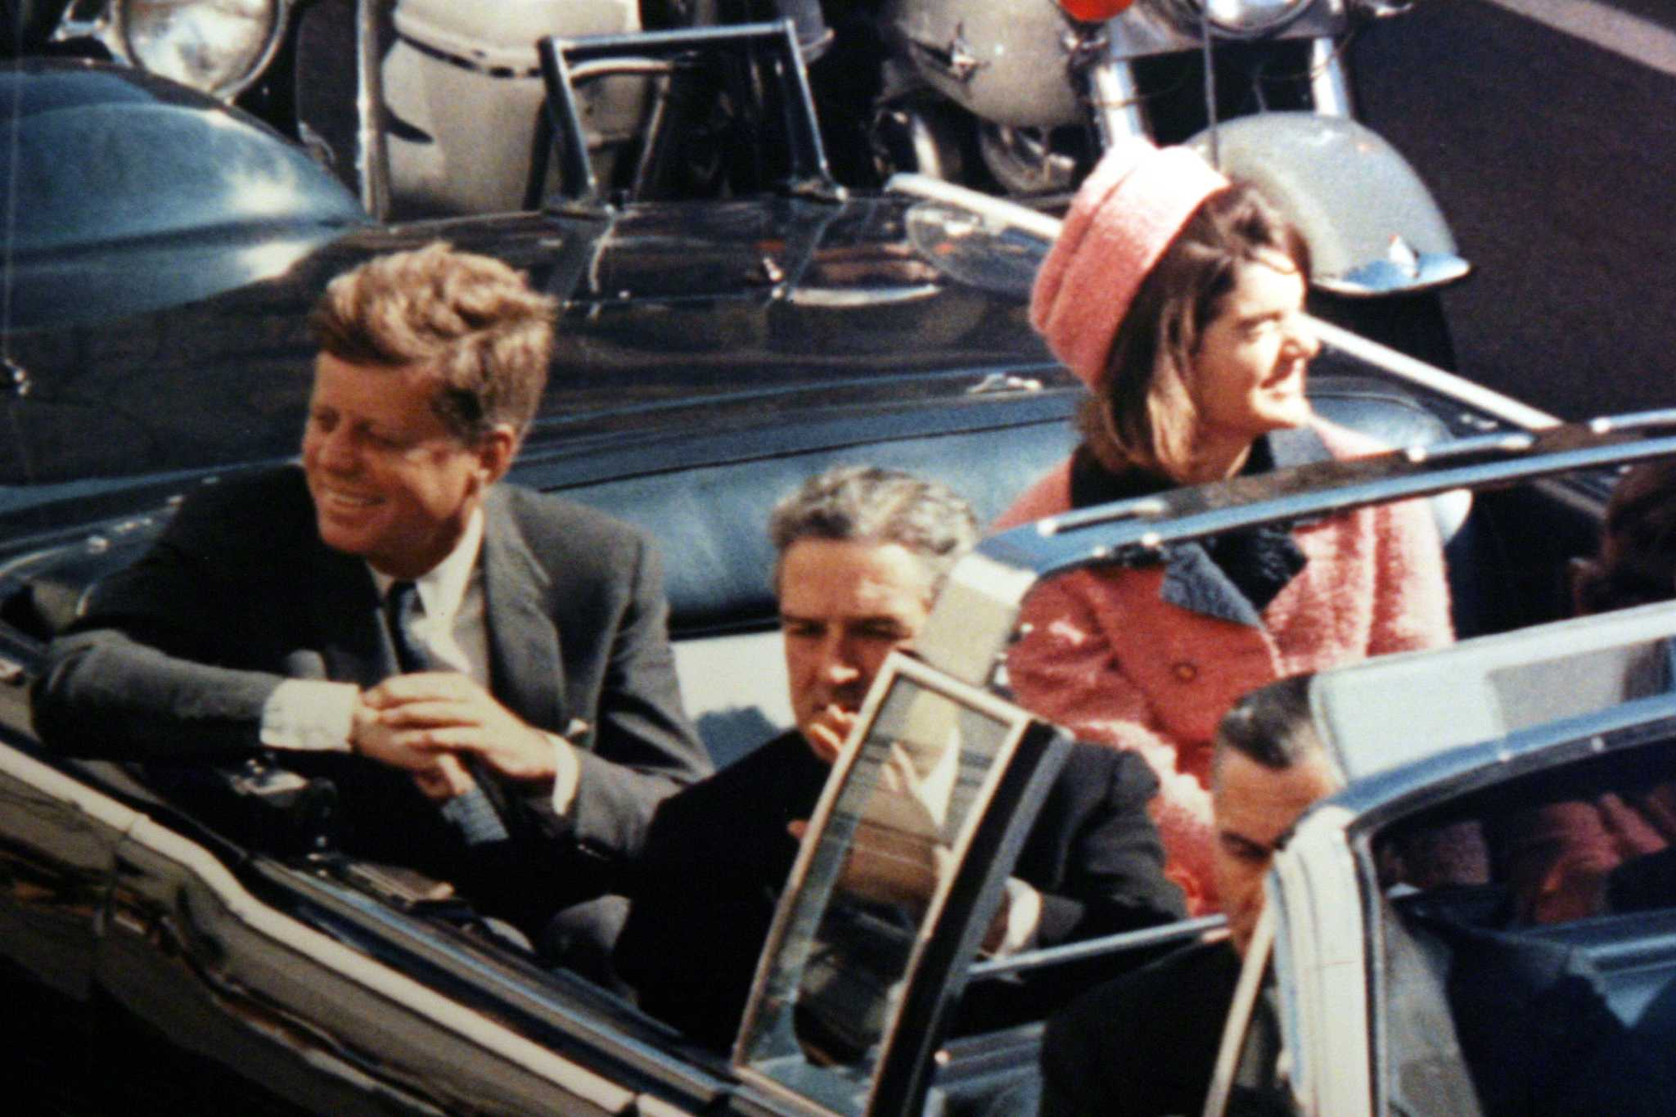

John F. Kennedy (JFK)
November 22, 1963
Notes:
On November 22nd, 1963, the President of the United States, John F. Kennedy, was assassinated. He was shot by a lone gunman named Lee Harvey Oswald while driving through the streets of Dallas in his motorcade. The assassination has been the subject of so much controversy that, 25 years ago, an act of Congress mandated that all documents related to the assassination be released this year. The first batch of released files has more than 6,000 documents totaling 34,000 pages, and the last drop of files contains at least twice as many documents.

Slide 35


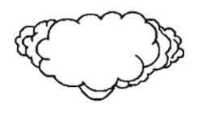
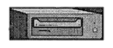

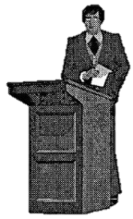
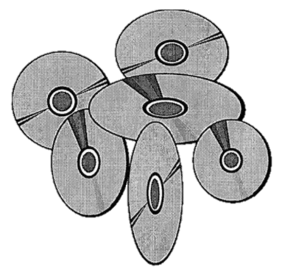
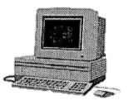

JFK FILES
COGNITIVE SEARCH
ARCHITECTURE
Custom skill: CIA Cryptonyms
Cognitive Services:
Computer Vision
OCR + Handwriting
Entity Linking
DECLASSIFIED
Azure Search
Cognitive
skill set
Blob
Storage
Azure Function
skill: Topics
Web App
(azsearch.js)
Cosmos DB
Azure Machine
Learning
Notes:
https://jfkfiles2.azurewebsites.net/

Slide 36
http://aka.ms/jfkfiles
Notes:
https://jfkfiles2.azurewebsites.net/

Slide 37
microsoft.com/ai

Slide 38
Thank You

